Slide 1

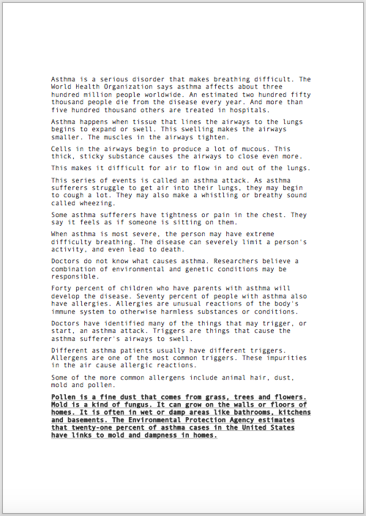
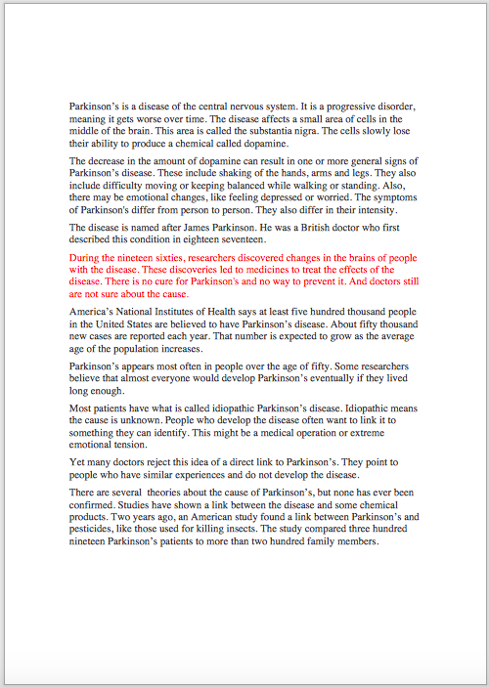
PDF Text Recognition using Google Vision API
Font, size, styles and color variation:
Word Error Rate (WER) up to 3.5%.
Bold/Underlined/Italic text
WER: 3%
Colored text
WER: 3.5%

Slide 2
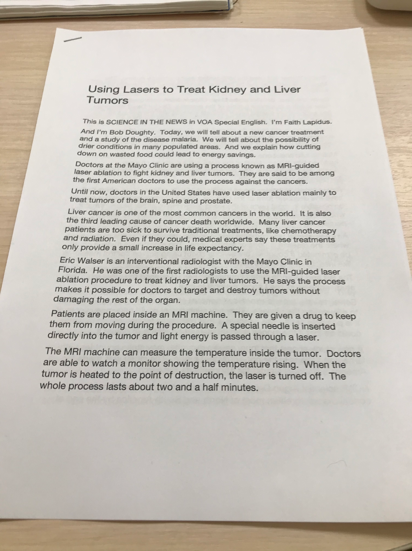
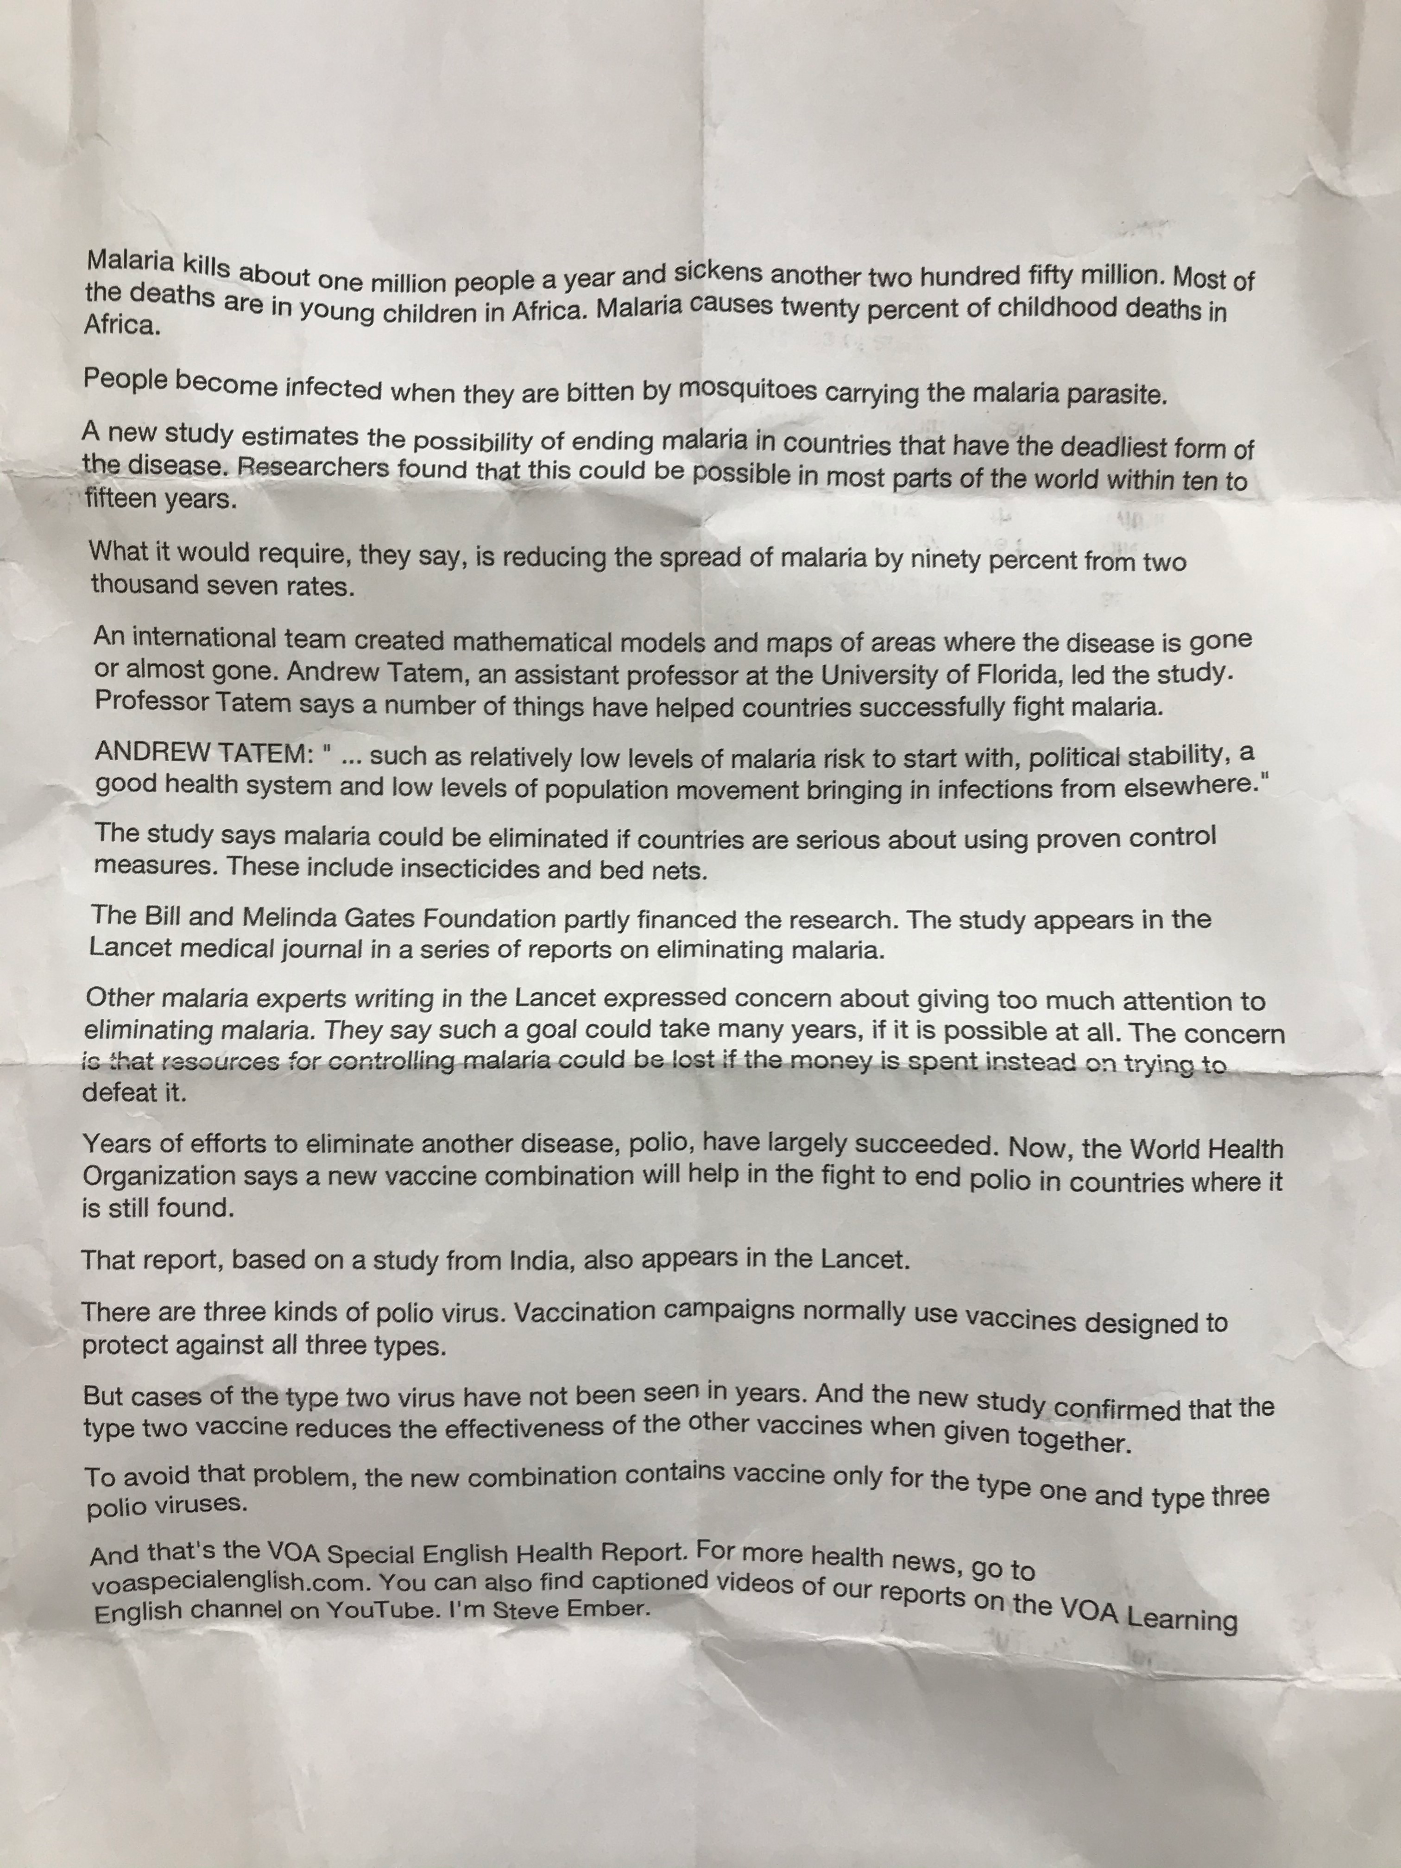
JPEG Text Recognition using Google Vision API
Various effects applied to JPEG image:
Word Error Rate (WER) up to 11%.
Perspective text
WER: 1%
Crumpled paper
WER: 1%

Slide 3
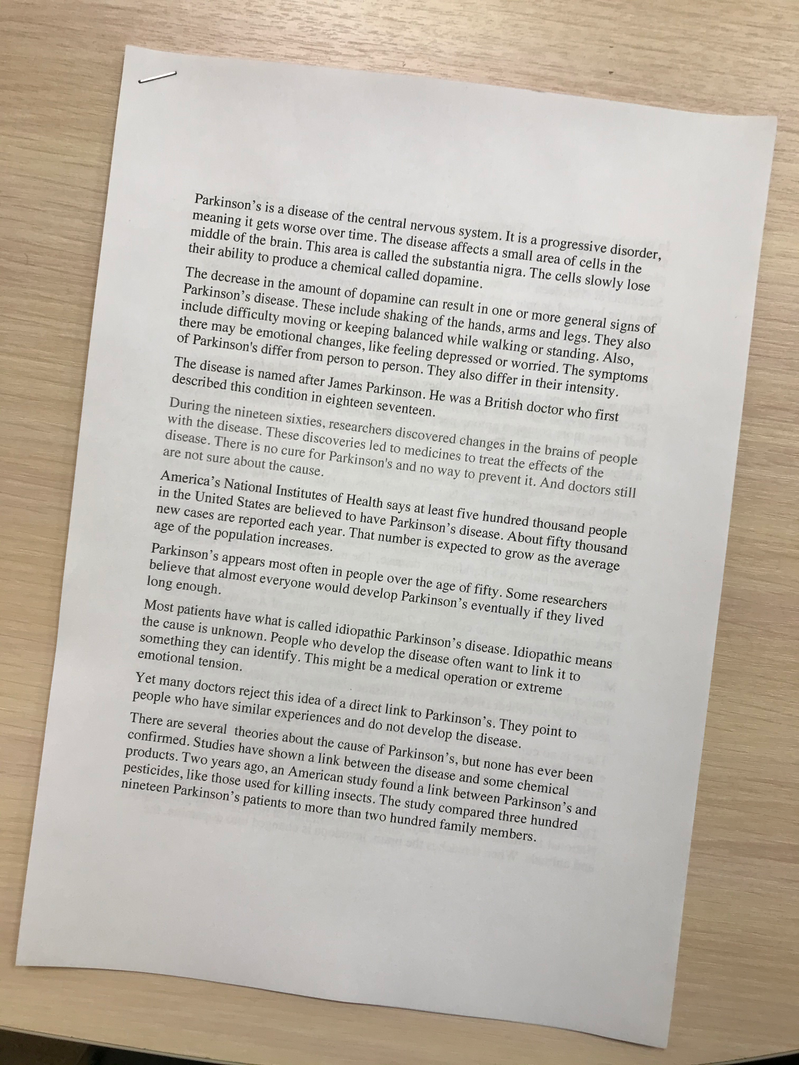
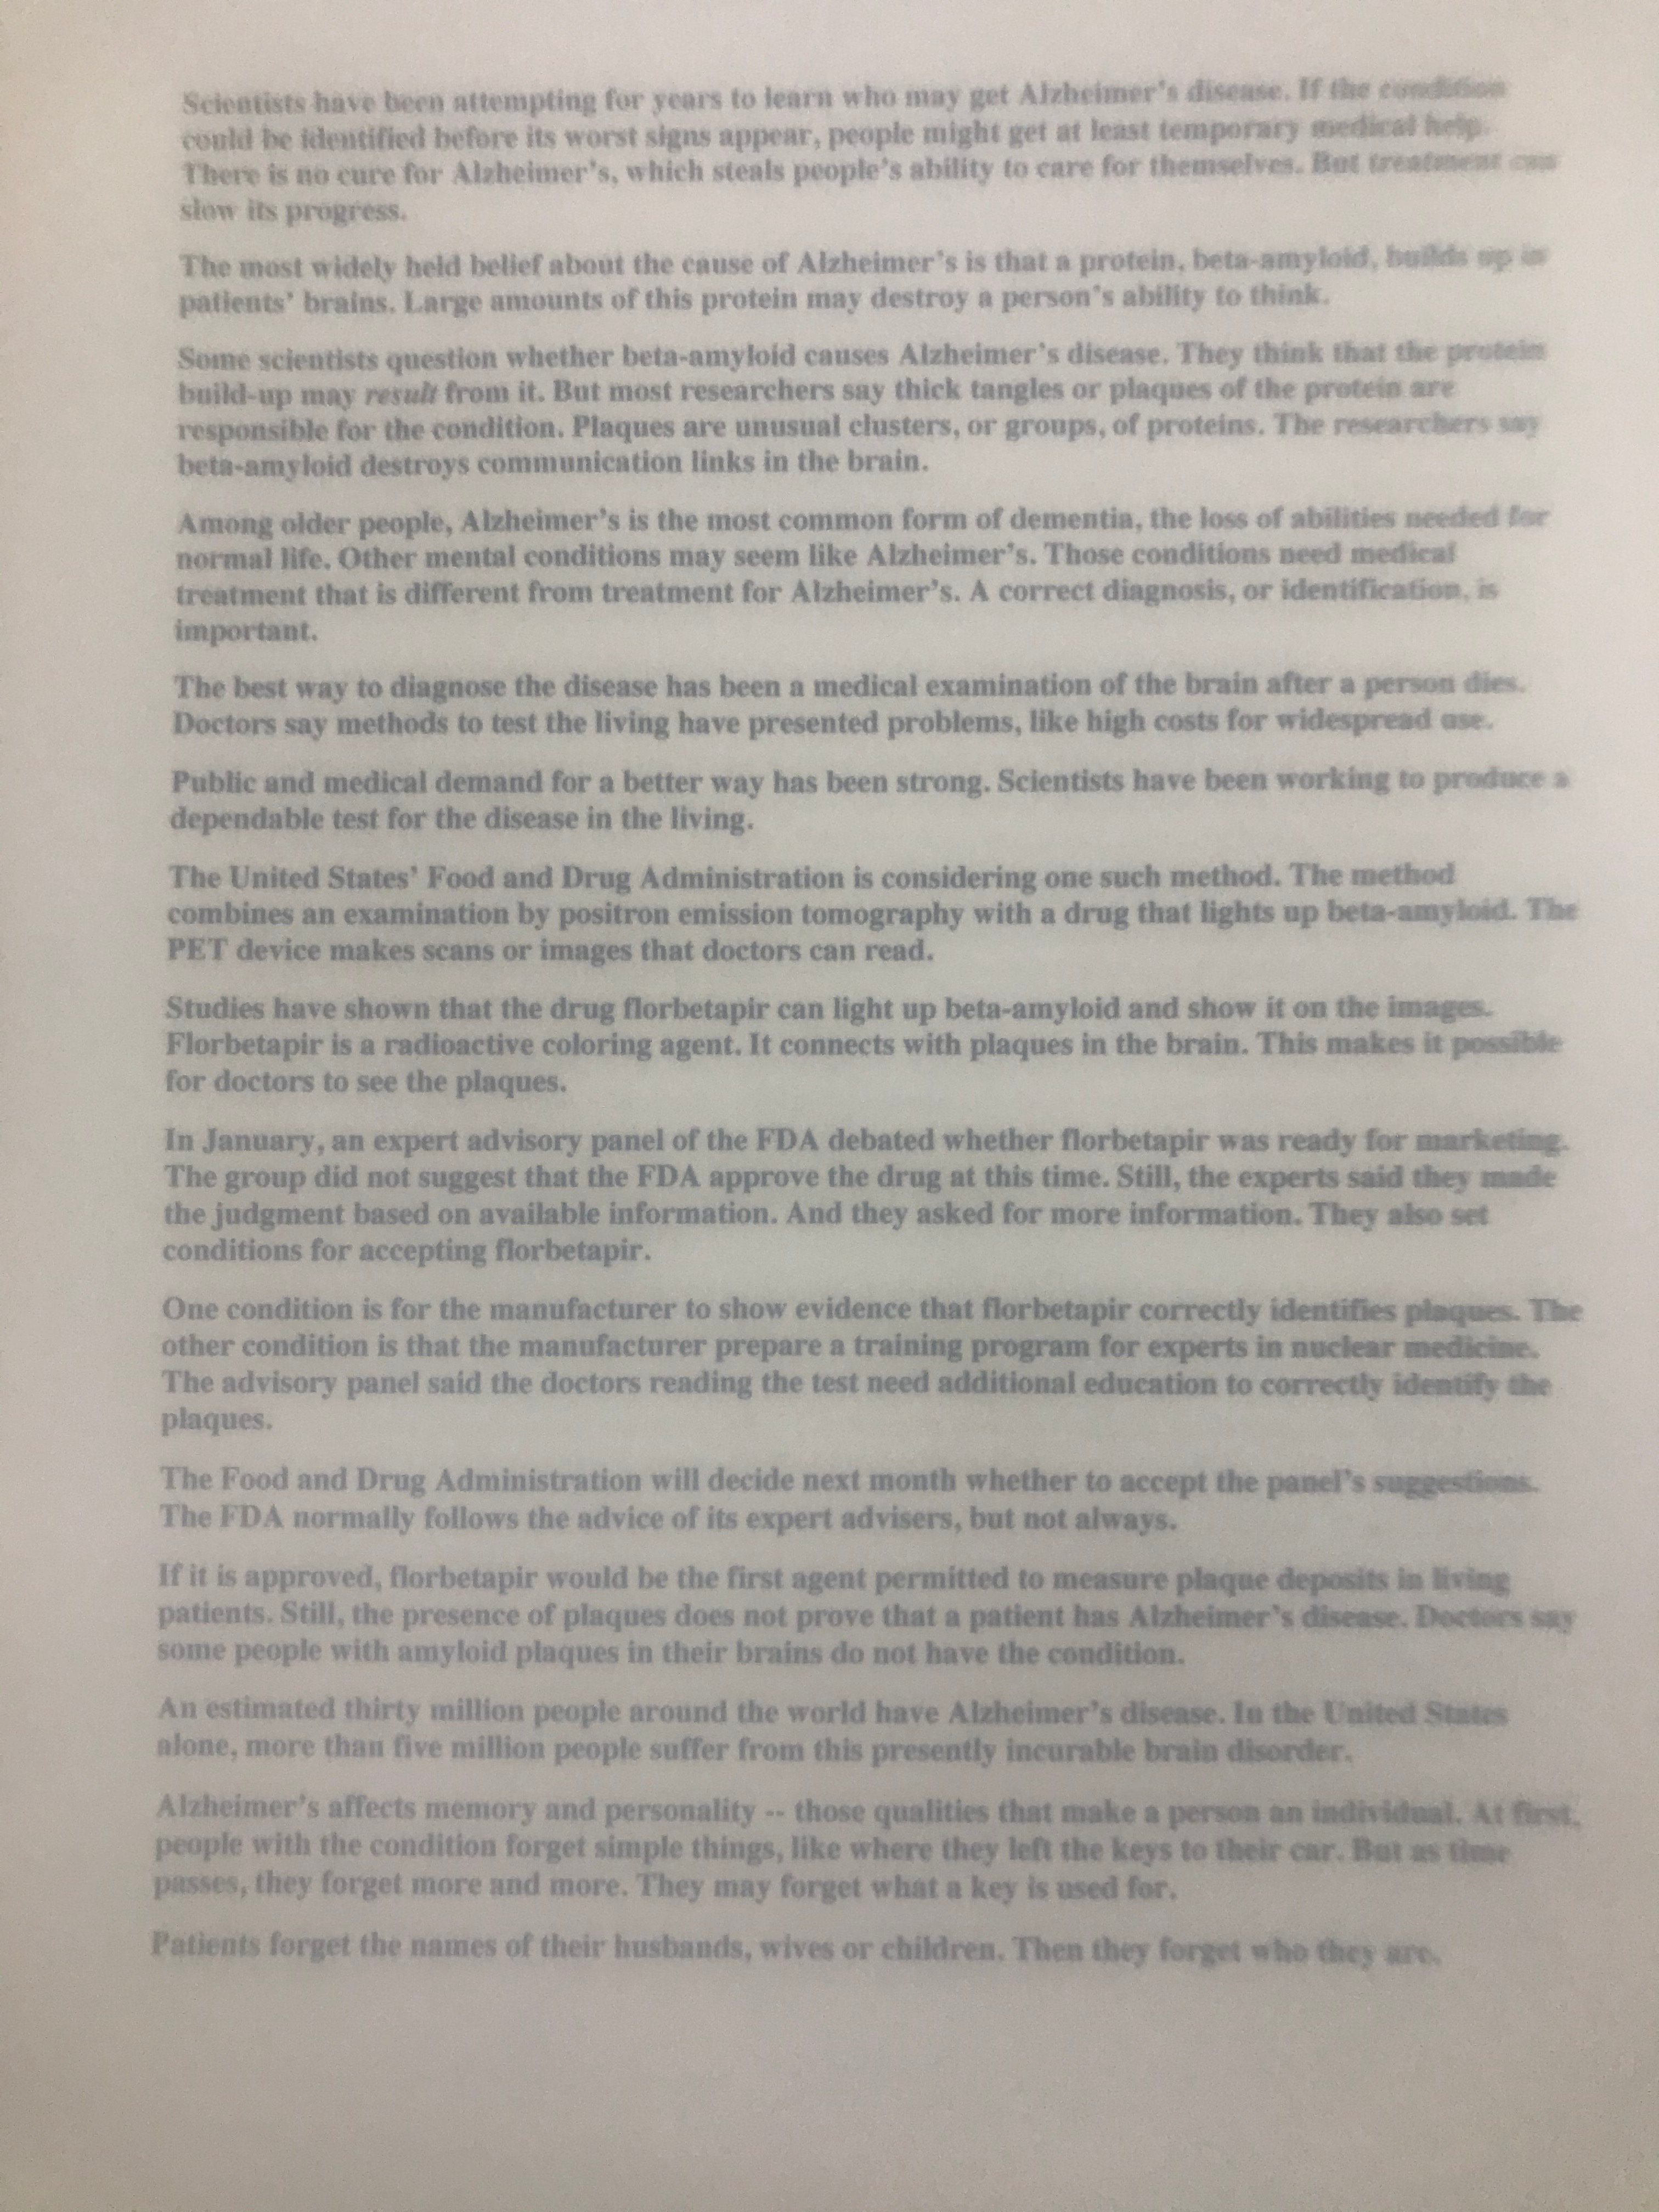
JPEG Text Recognition using Google Vision API
Other effects applied:Out of focus image, landscape orientation, presence of external objects, etc.
Rotated sheet
WER: (2-9)%
Blurry image
WER: 11%

